Slide 1

Design And Analysis Of Algorithms-Assignment 3
GROUP 2:
ADITYA RAJ IIT2017005
MAYANK MRINAL IIT2017006
MOHIT PAHUJA IIT2017007
ARASHPREET SINGH IIT2017008

Slide 2
PROBLEM
Create a matrix of size 50×50 of numbers ranging from 0 to 9. Find the length of largest sorted component reverse
diagonally.

Slide 3

INTRODUCTION
In this problem we have to generate 50*50 matrix and
find the length of largest sorted component. For generating
random numbers between 0 to 9 we are using random
function present in c++ library . For finding largest sorted
component we are using li and ld , for ascending and
descending respectively , because sorted component can be
either in ascending or in descending order.

Slide 4
In this we have first created a 50*50 matrix using 2D
array and filled it with random numbers between 0 to
9.
For generating random numbers we are using the
present random function in c++ library.
We have taken variable maxl which will store the length
of largest sorted component , initiated with value of
2, as minimum length of largest sorted sequence is 2.
Since we have to move reverse diagonal we iterate
reverse diagonally and check whether a given number of
particular block is greater/less than or equal to previous
number in a diagonal fashion.
For above process we are using two for loops.
ALGORITHM 1

Slide 5
PSEUDOCODE

Slide 6
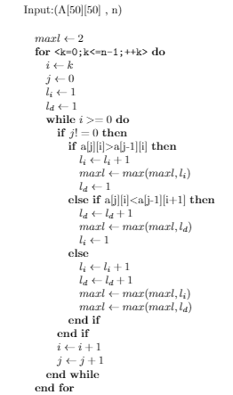

Slide 7
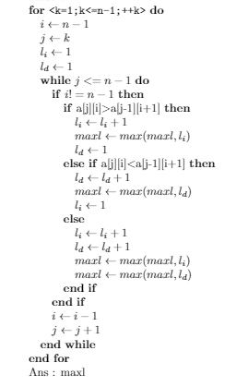

Slide 8
ALGORITHM ANALYSIS
TIME COMPLEXITY
We have calculated the time consumed in each step in terms of number of computations,as given in the above pseudo code.
In question we have been restricted to generate a 50*50 matrix so to traverse the matrix in reverse diagonal time complexity will be in the order of 50^2
.
Thus for general value of size of matrix let say n, the time complexity is going to be in order of n^2.
The best case, worst case and average case time complexity will be same i.e.
O(n^2).

Slide 9
SPACE COMPLEXITY
Since the number of memory location depends on the
size of the square matrix , let the variable size of square
matrix be n ,therefore the space complexity will be in order of O(n^2).

Slide 10
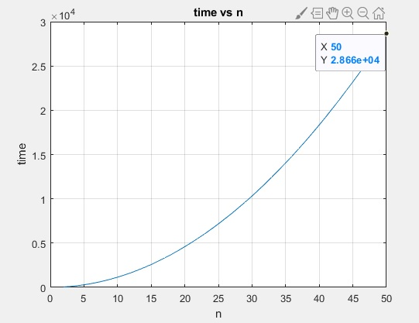
TIME COMPLEXITY
GRAPH

Slide 11
The graph depicts that the plot between the size of matrix i.e. n and time which comes out to be approximately 11.375n^2+ 1.375n−0.25.
The integrated Development environment of C++ is used for processing the algorithm and graphical analysis is done using MATLAB plot function.
EXPERIMENTAL STUDIES

Slide 12
CONCLUSION
In this document we conclude that our algorithm has a polynomial time complexity with order of n^2 for all the cases i.e. best,worst and average case . The space complexity is also of the order n^2( where n is the size of matrix.)
Therefore both time and space complexity is O(n^2)..

Slide 13
REFERENCES
1.https://www.geeksforgeeks.org/zigzag-or-diagonal-
traversal-of-matrix/
2.[CLR96] Thomas H. Cormen, Charles E. Leiserson, and
Ronald L Rivest. Introduction to algorithms. The MIT press,
2nd edition, 1996.
3.[DW96] Nell Dale and Henry M. Walker. Abstract data
types: specifications, implementations, and applications. D.
C. Heath and Company, Lexington, MA, USA, 1996.

Slide 14
THANK YOU

